Slide 1
City of Decatur, Alabama Planning Commission
June 21, 2016

Slide 2
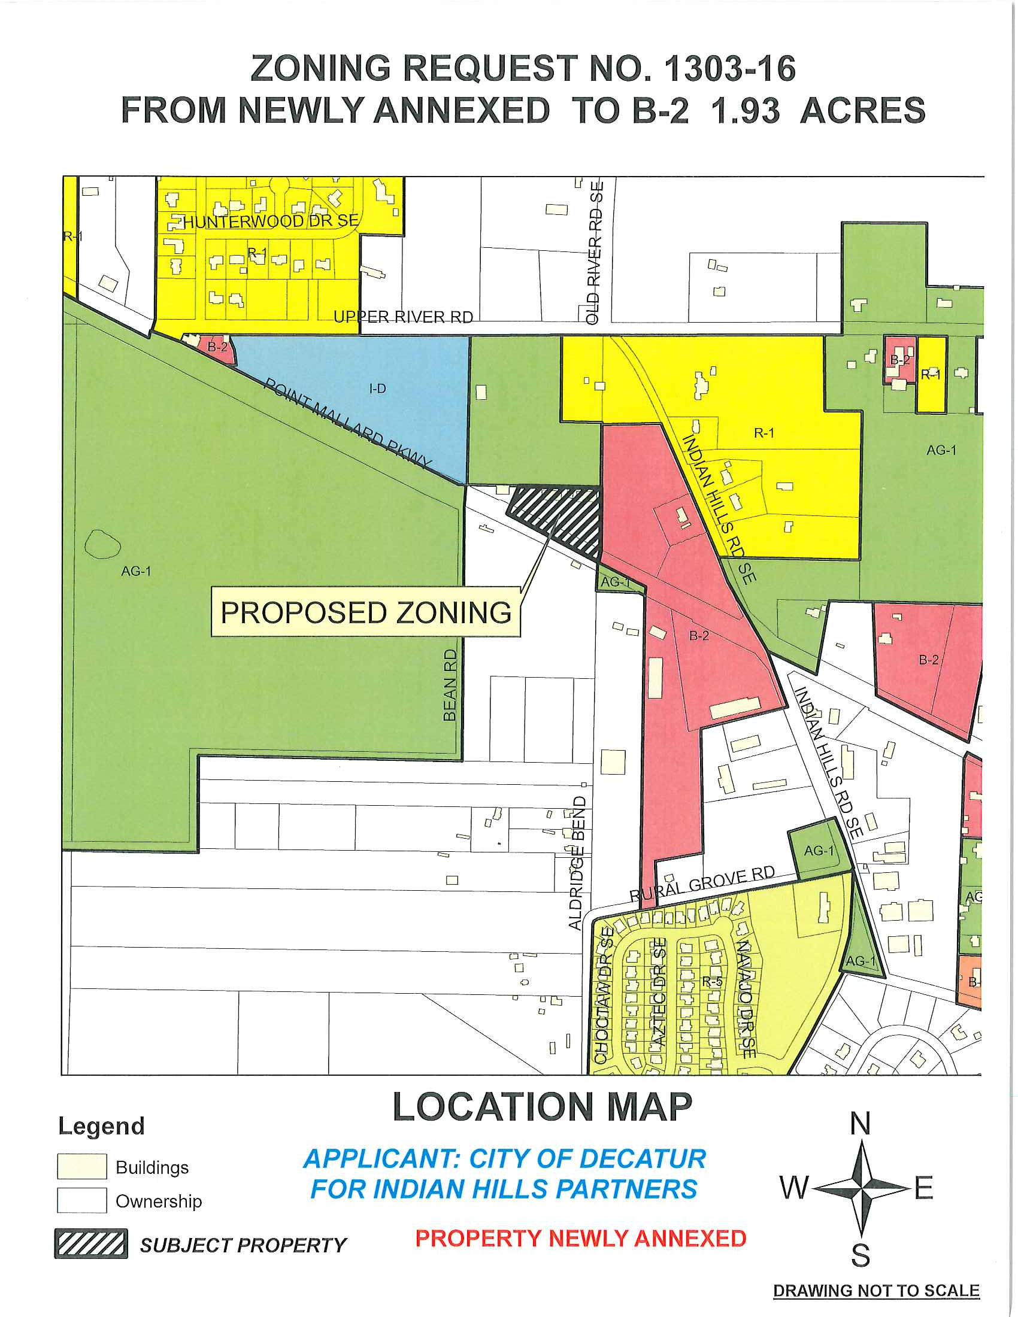

Slide 3
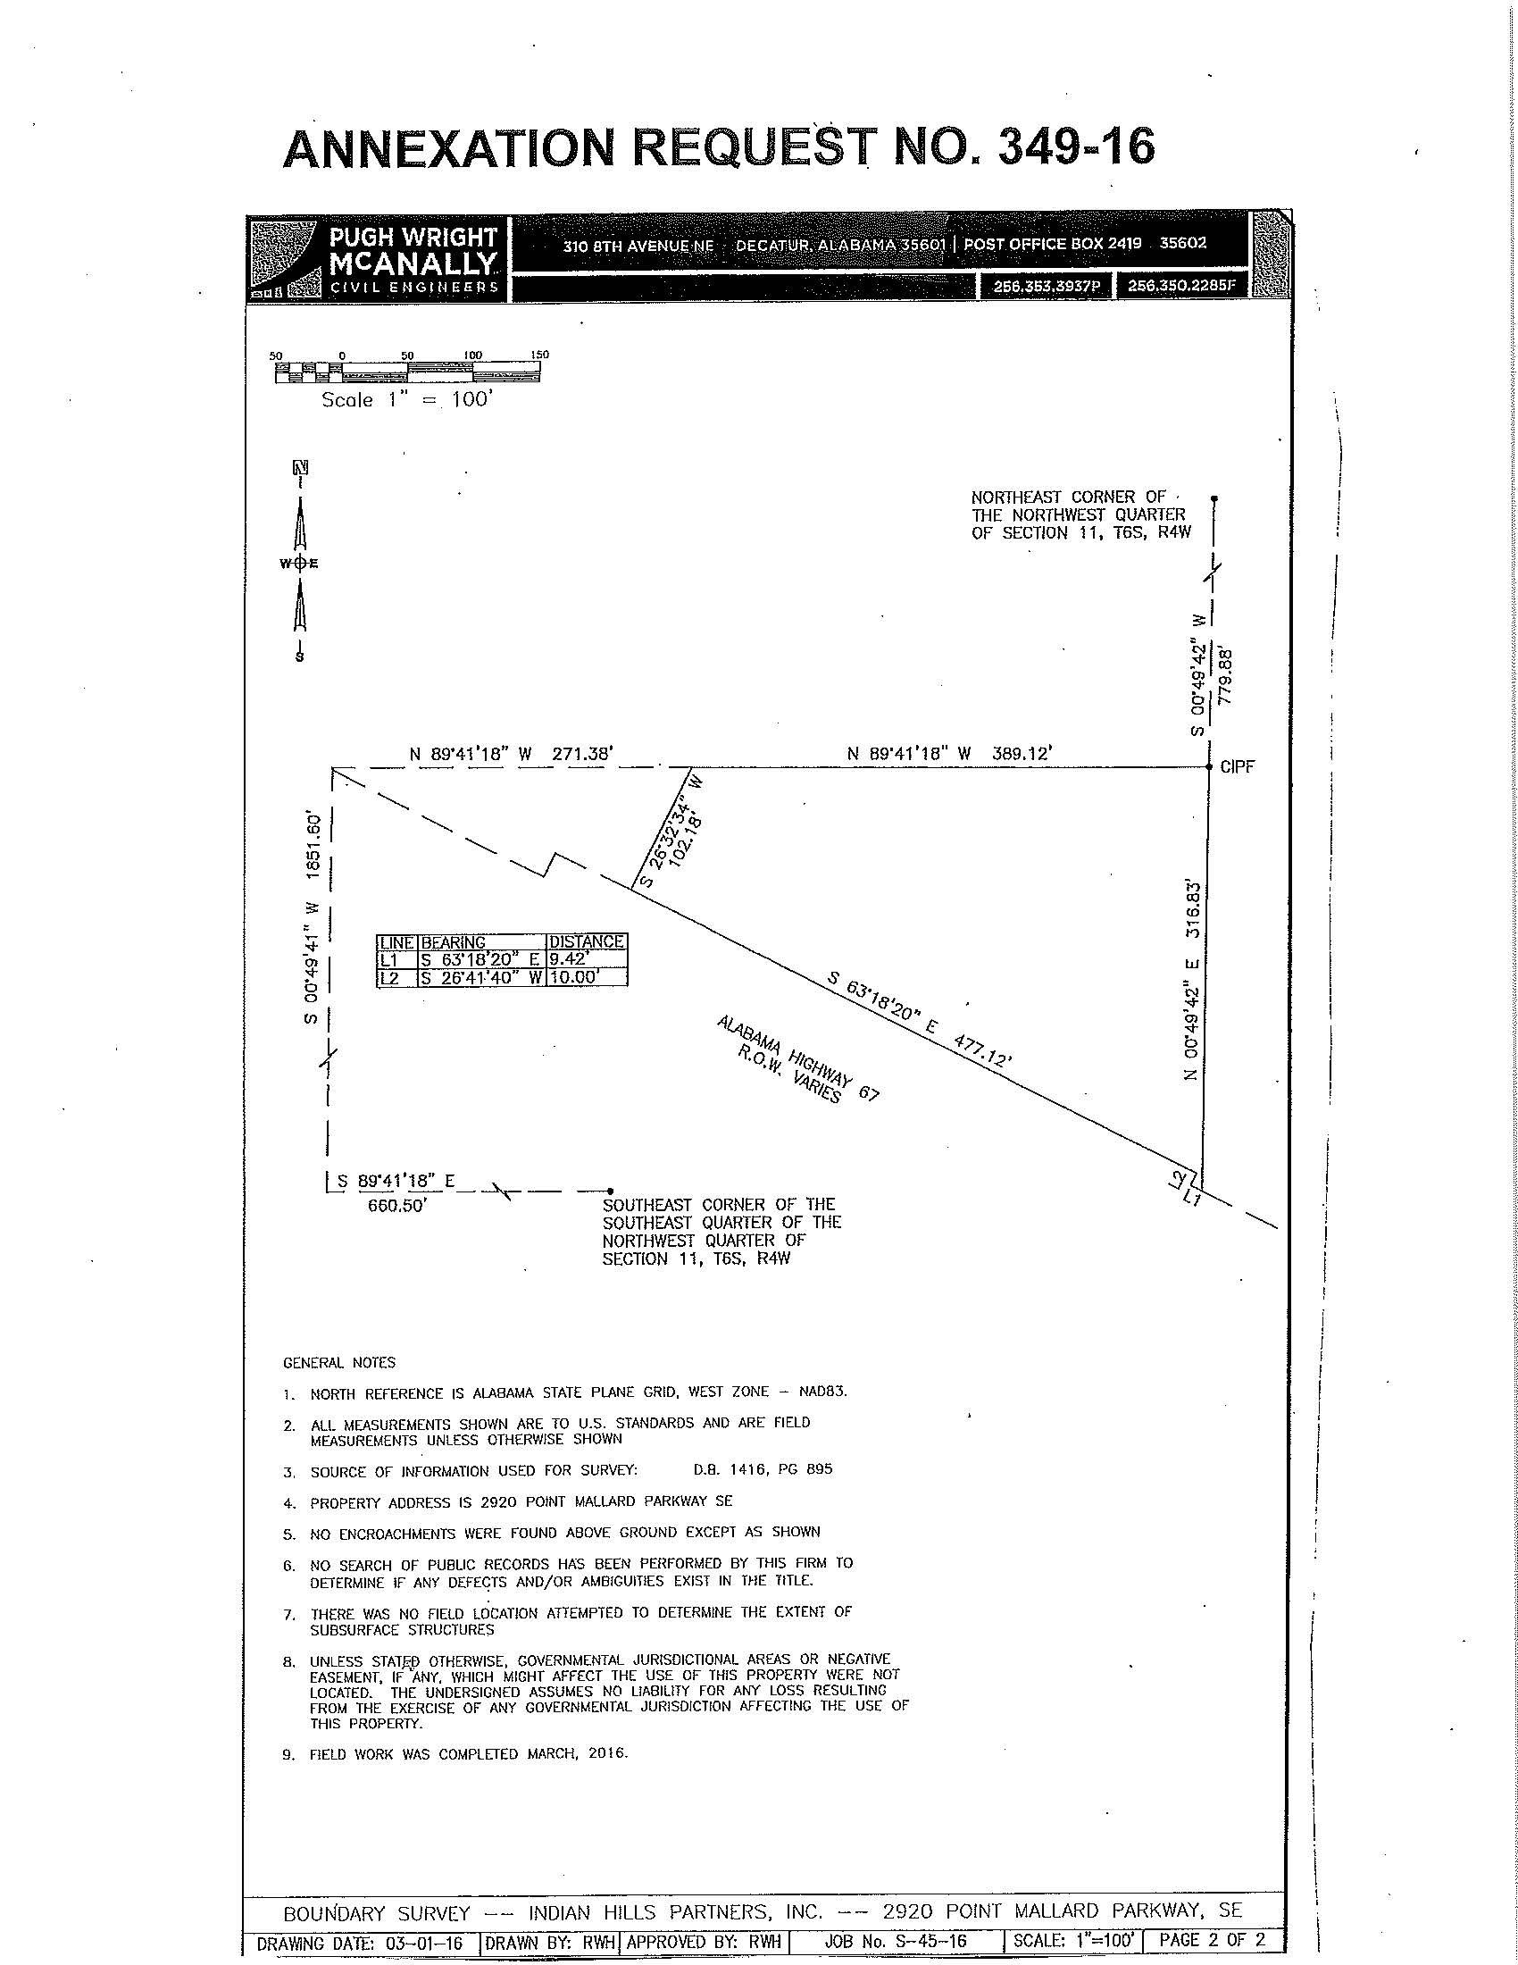
ZONING 1303-16

Slide 4
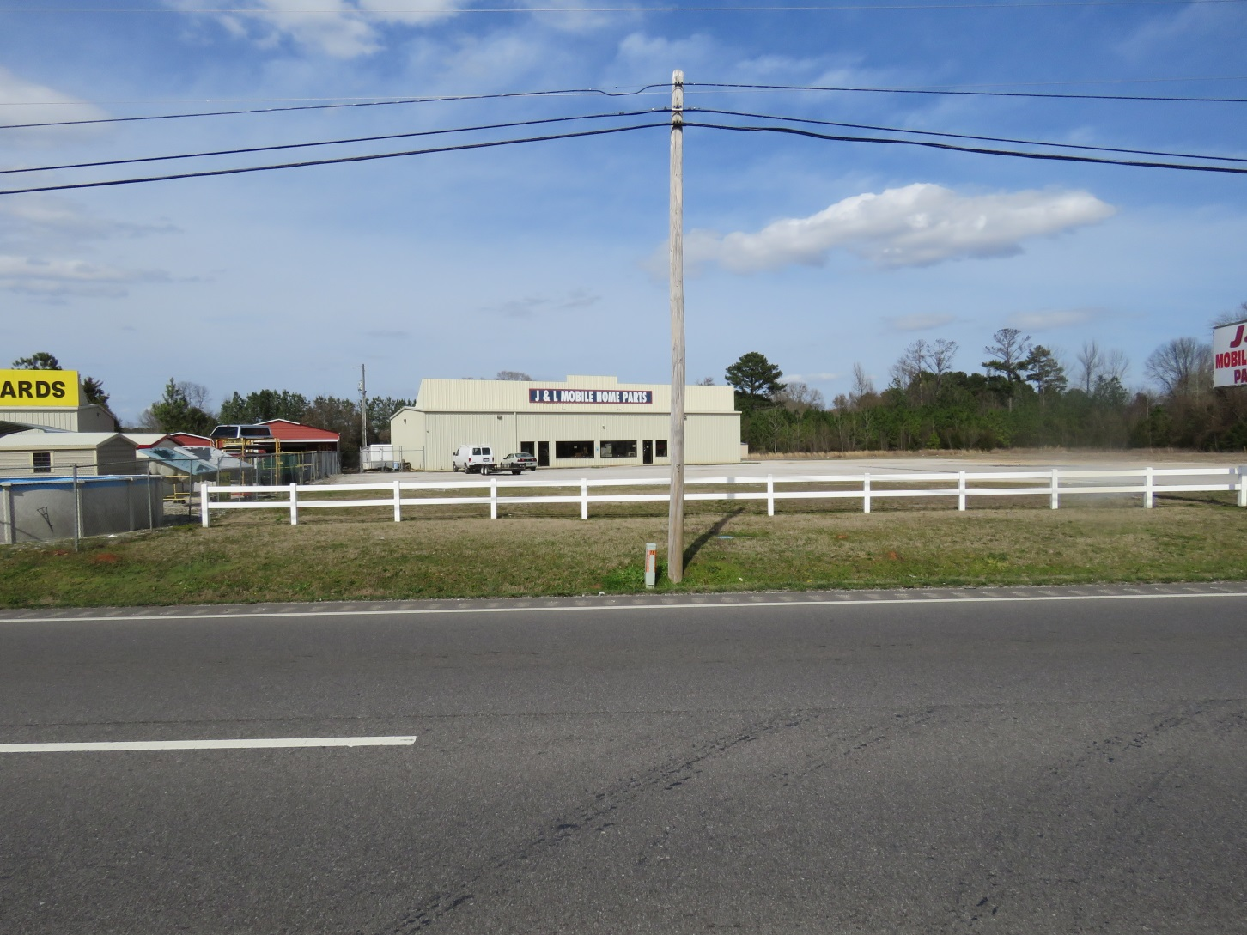
ZONING 1303-16

Slide 5
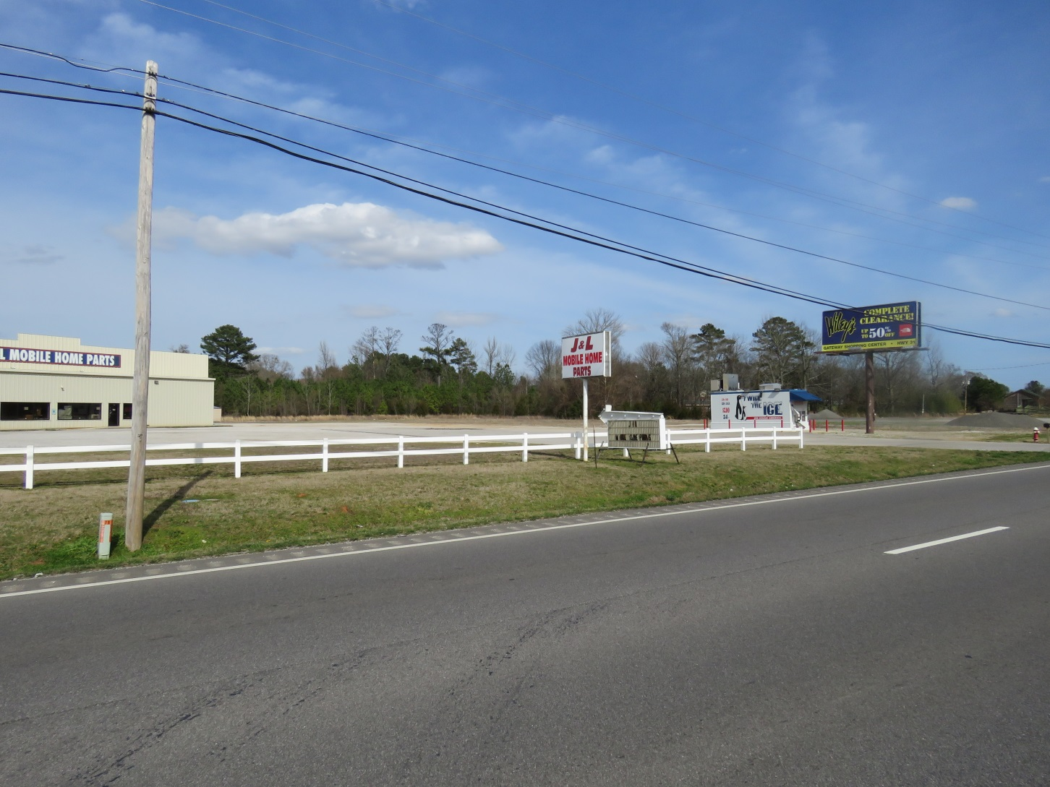
ZONING 1303-16

Slide 6
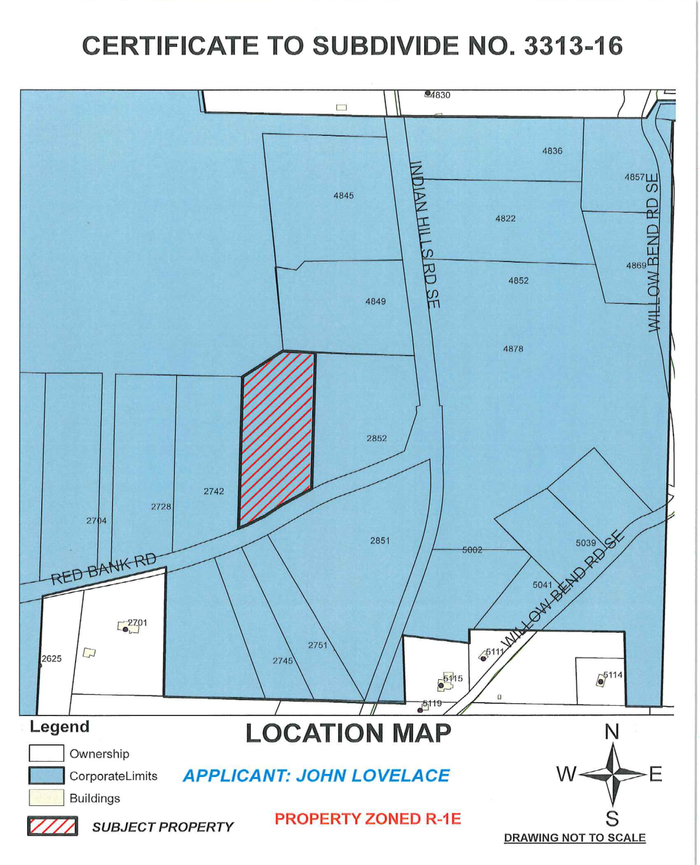

Slide 7
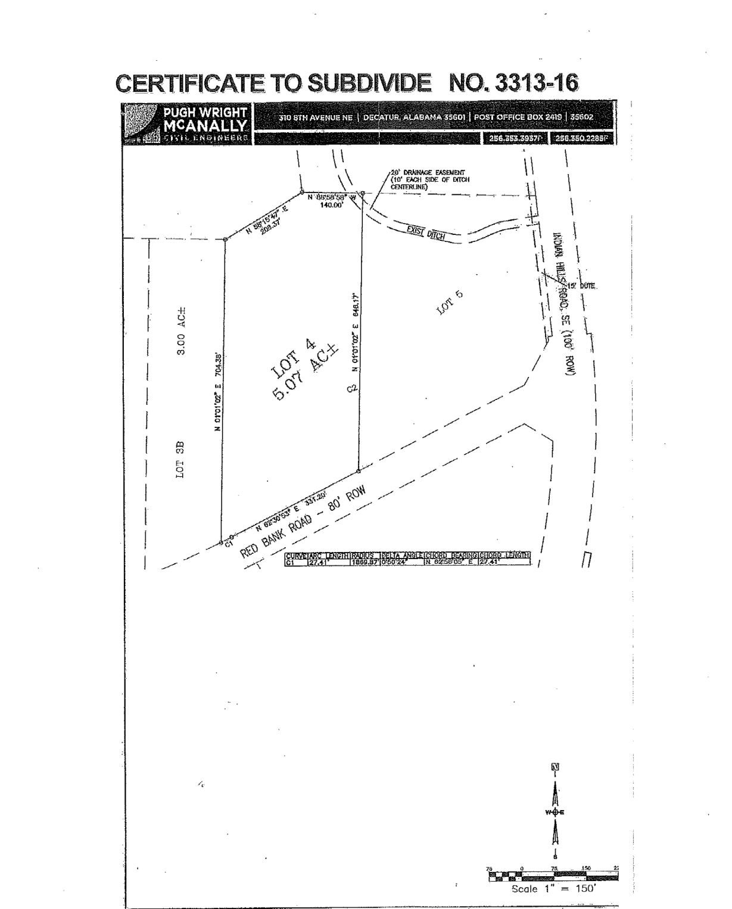

Slide 8
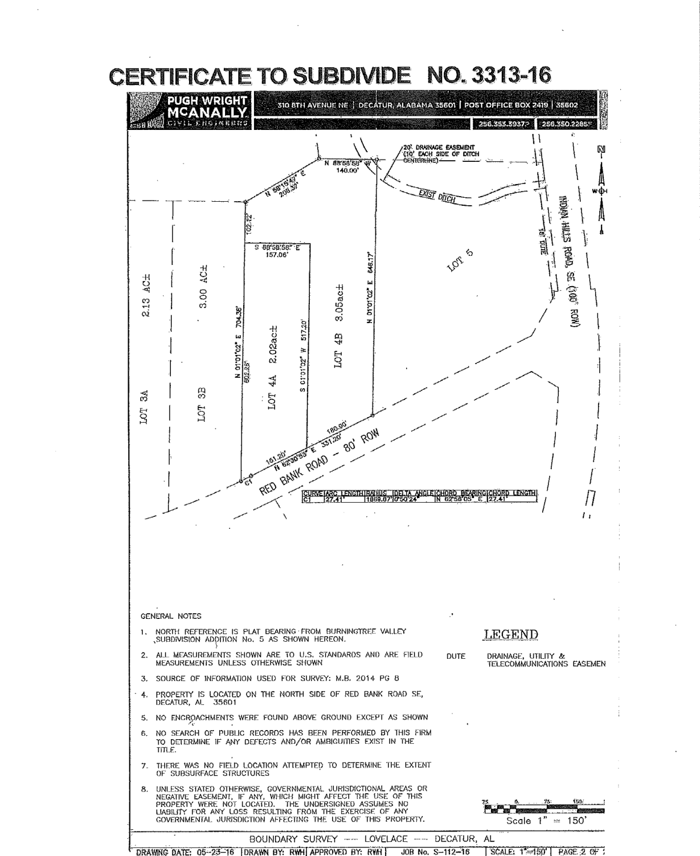

Slide 9
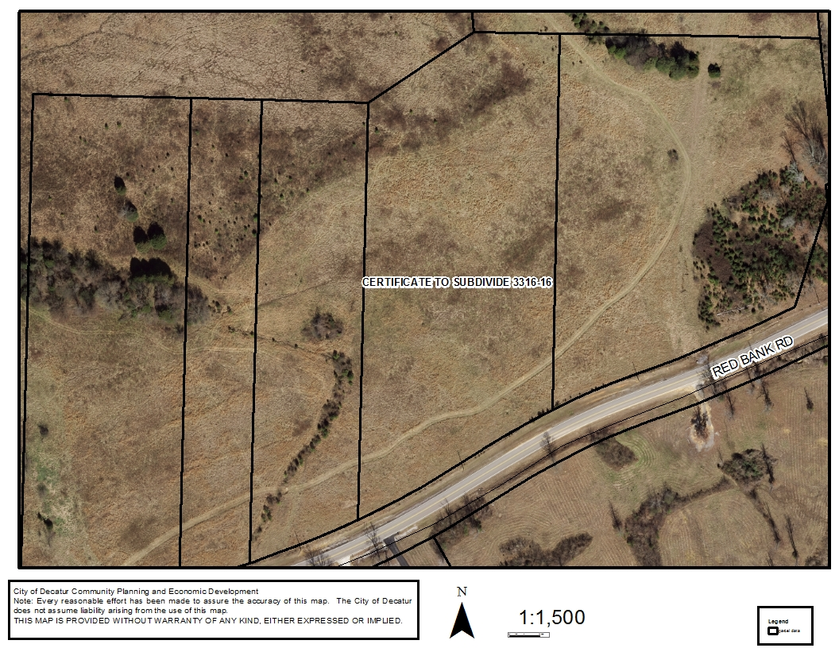
3313-16 Certificate to Subdivide

Slide 10
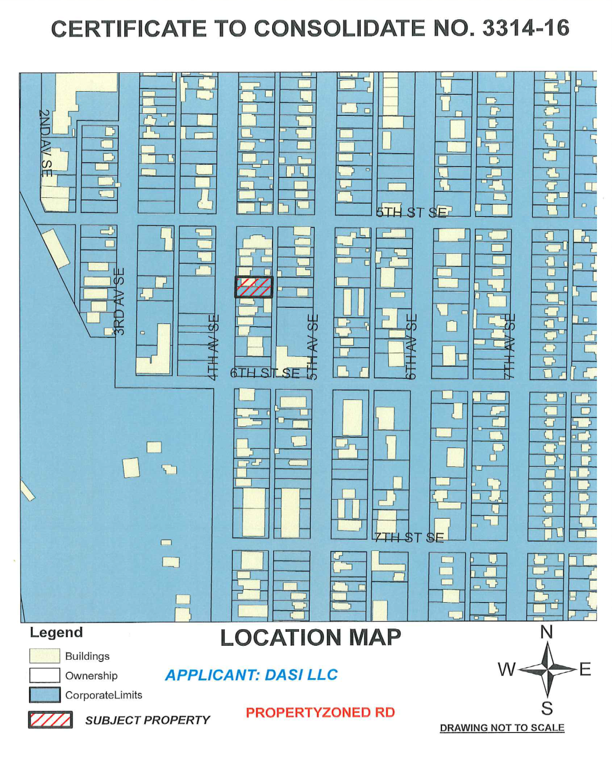

Slide 11
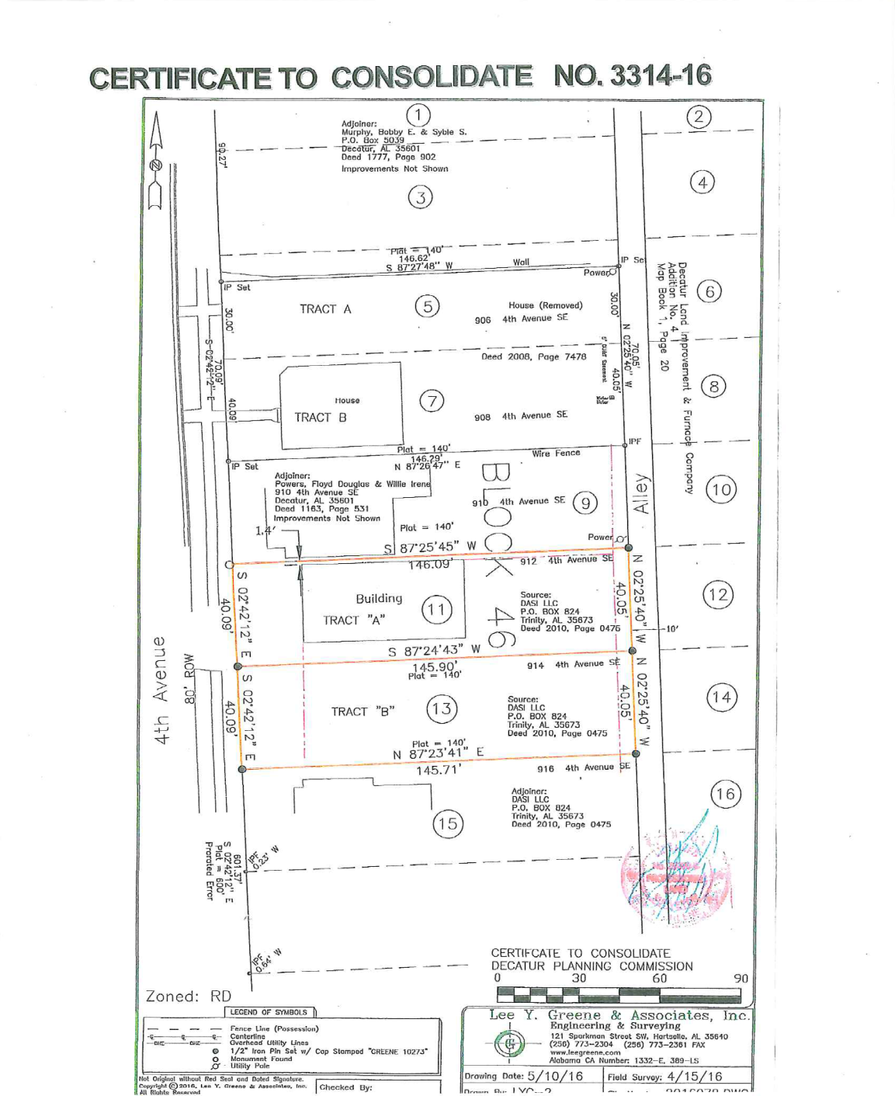

Slide 12
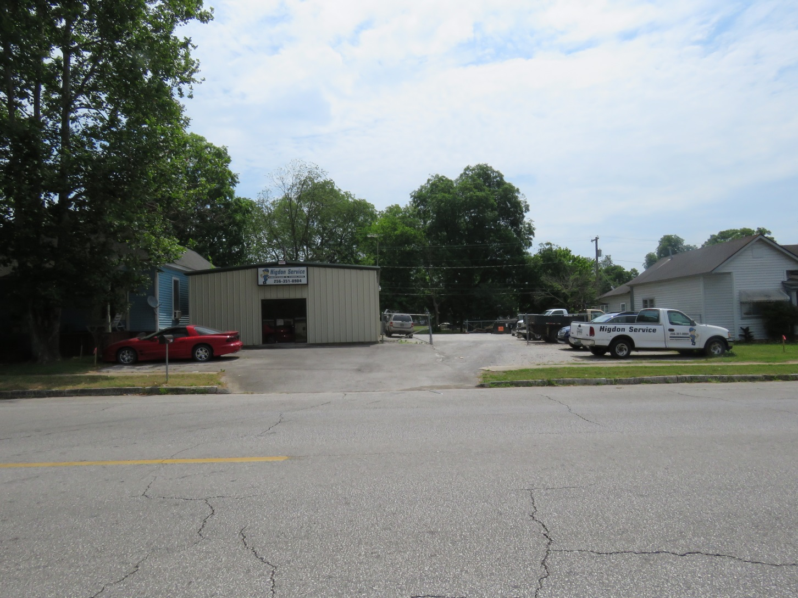
3314-16 Certificate to Consolidate

Slide 13
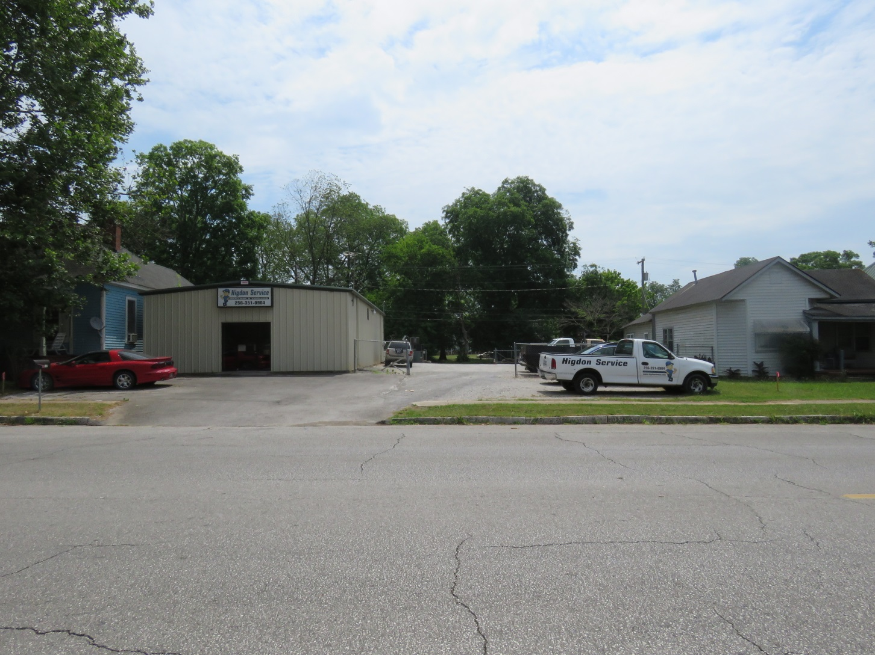
3314-16 Certificate to Consolidate

Slide 14
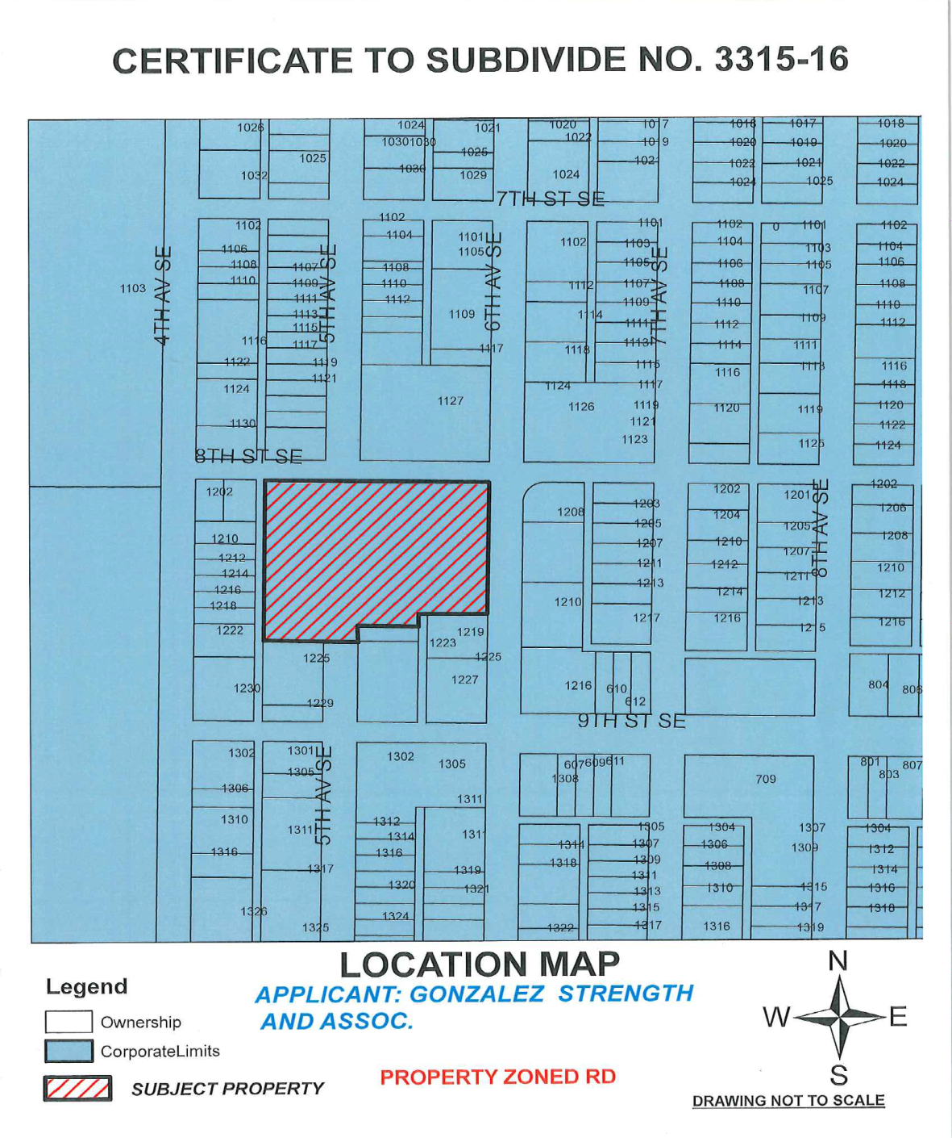

Slide 15
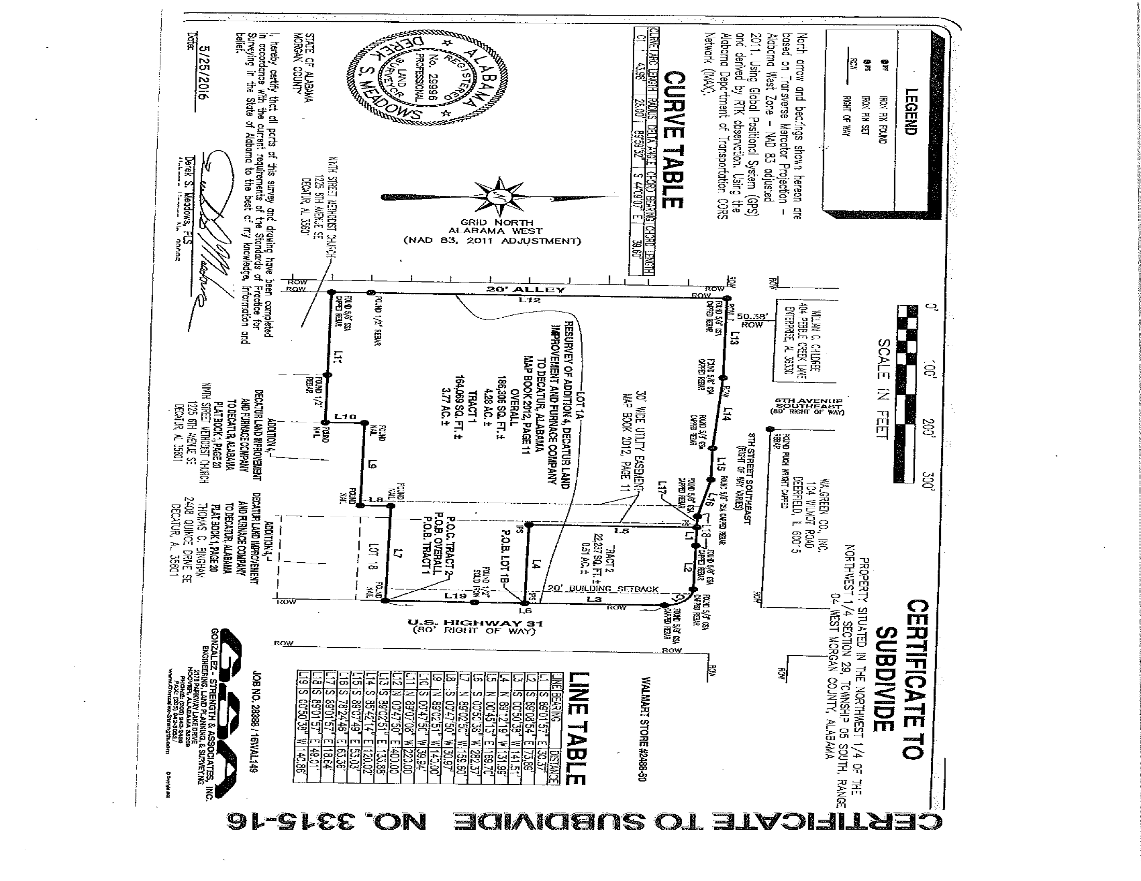

Slide 16
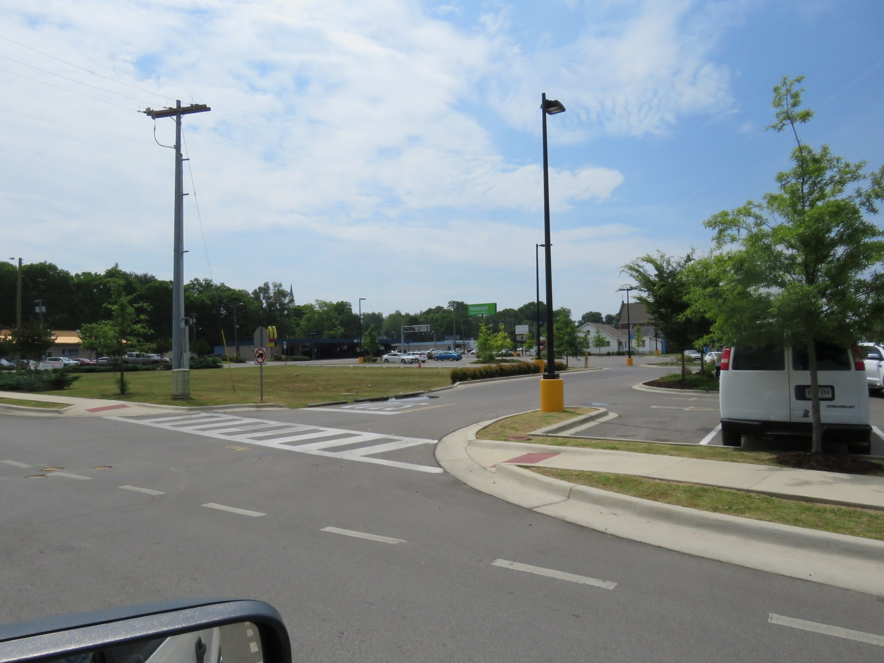
3315-16 Certificate to Subdivide

Slide 17
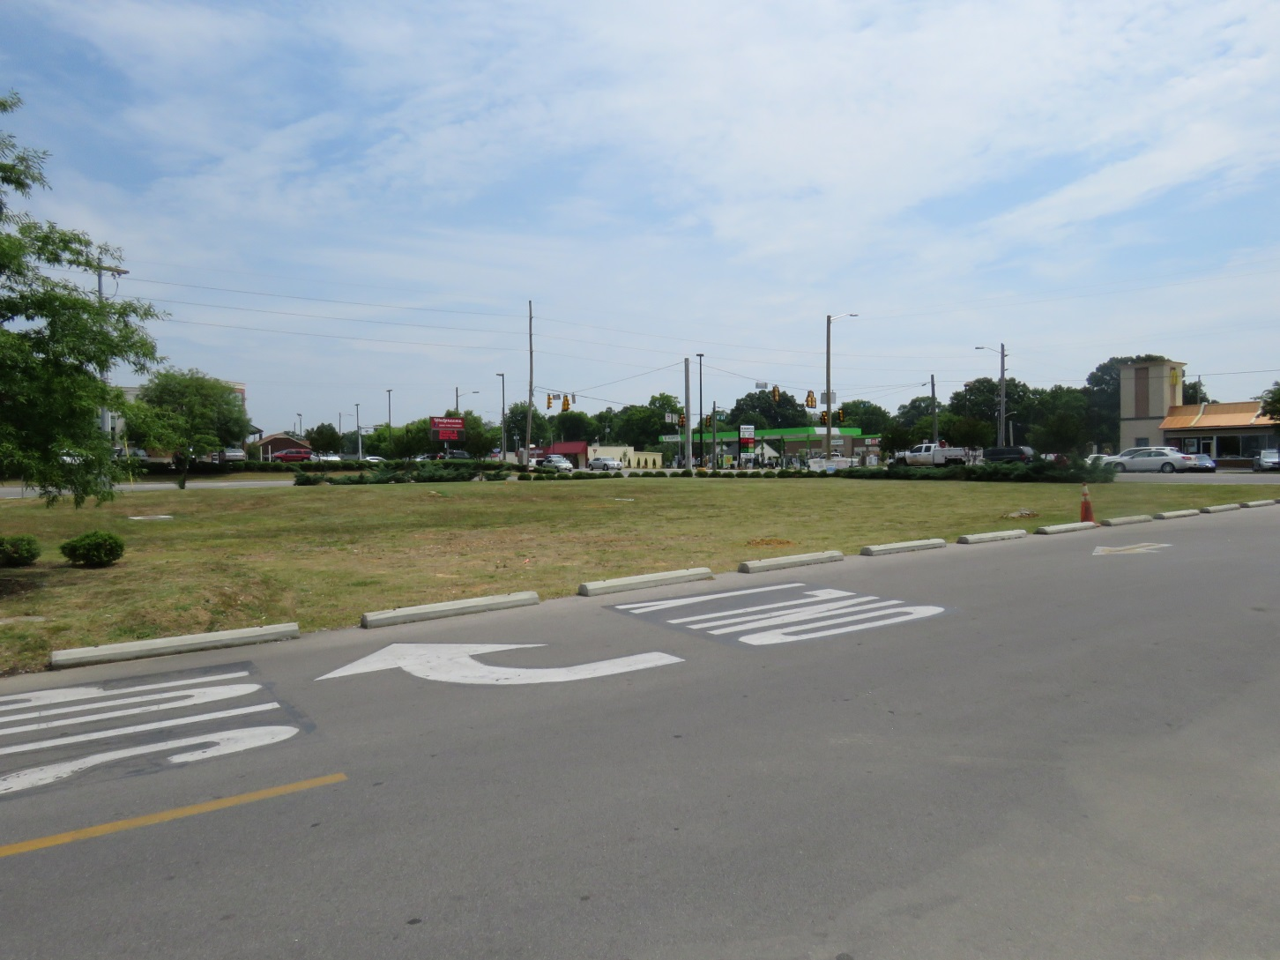
3315-16 Certificate to Subdivide

Slide 18
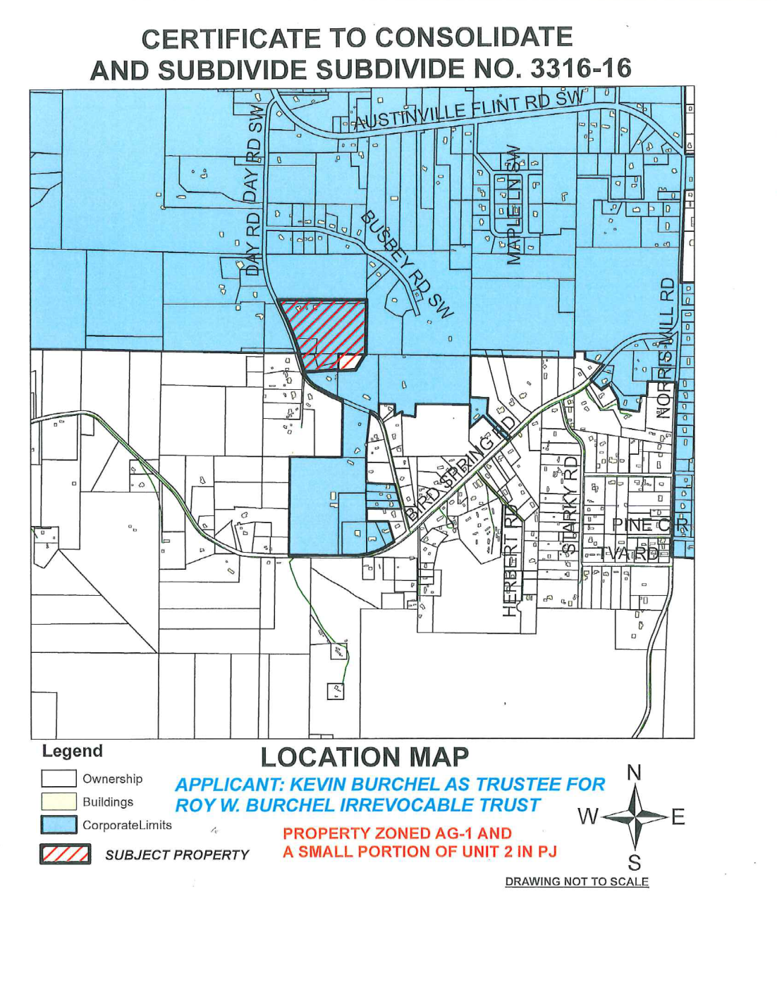

Slide 19
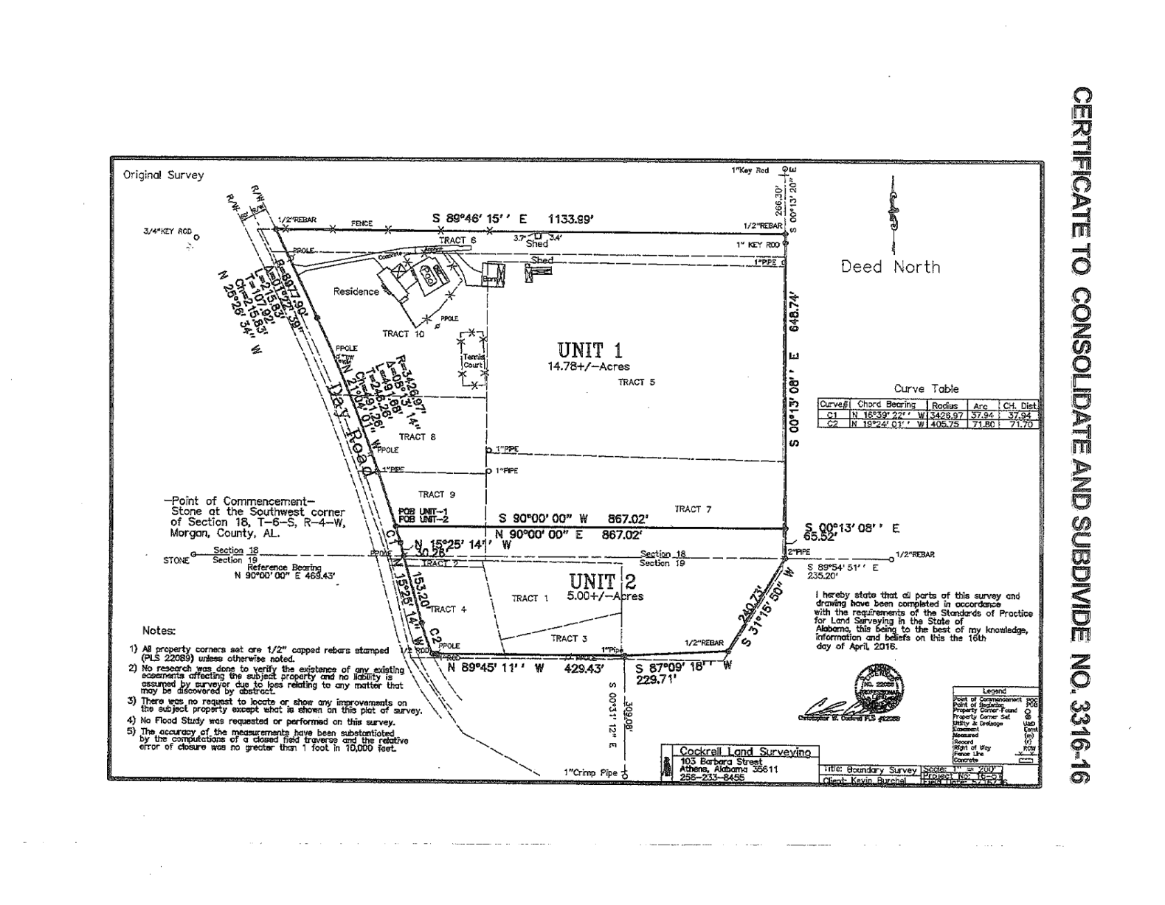

Slide 20
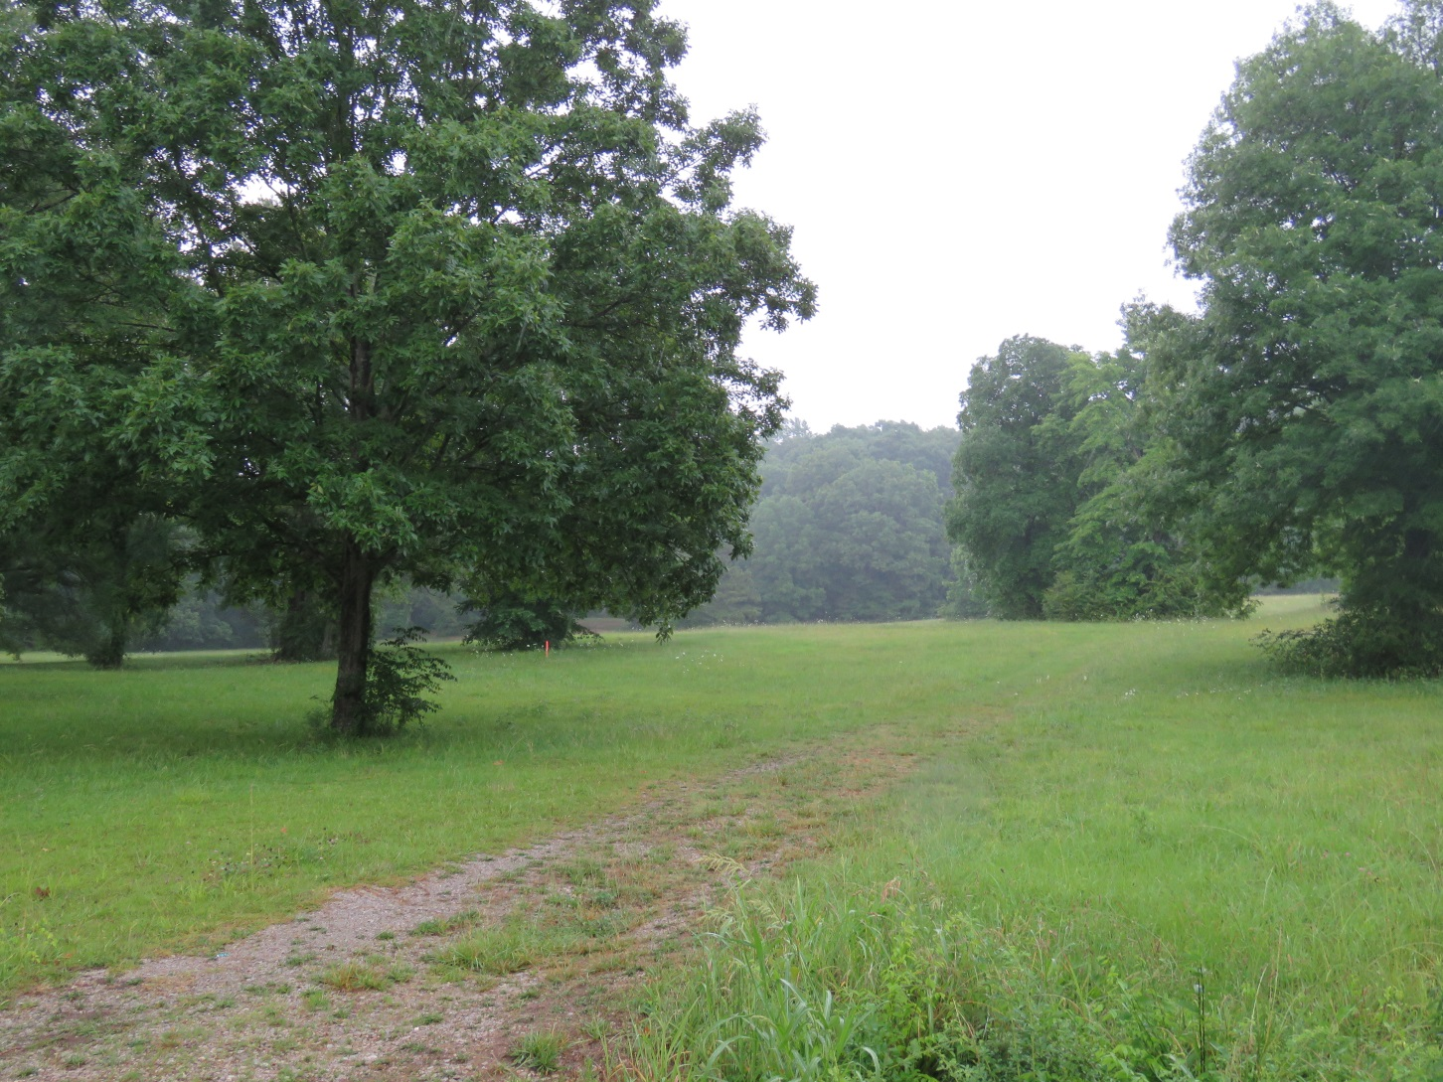
3316-16 Certificate to Consolidate & Subdivide

Slide 21
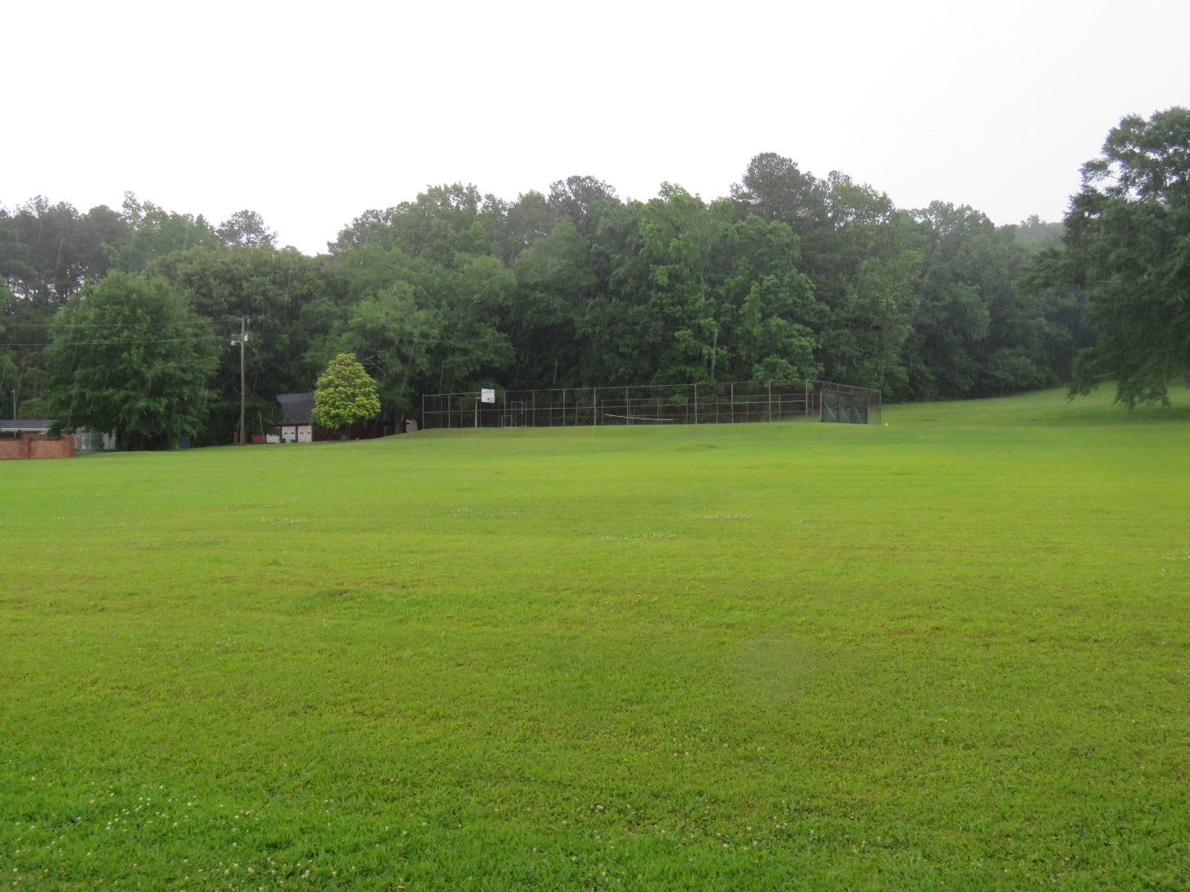
3316-16 Certificate to Consolidate & Subdivide

Slide 22
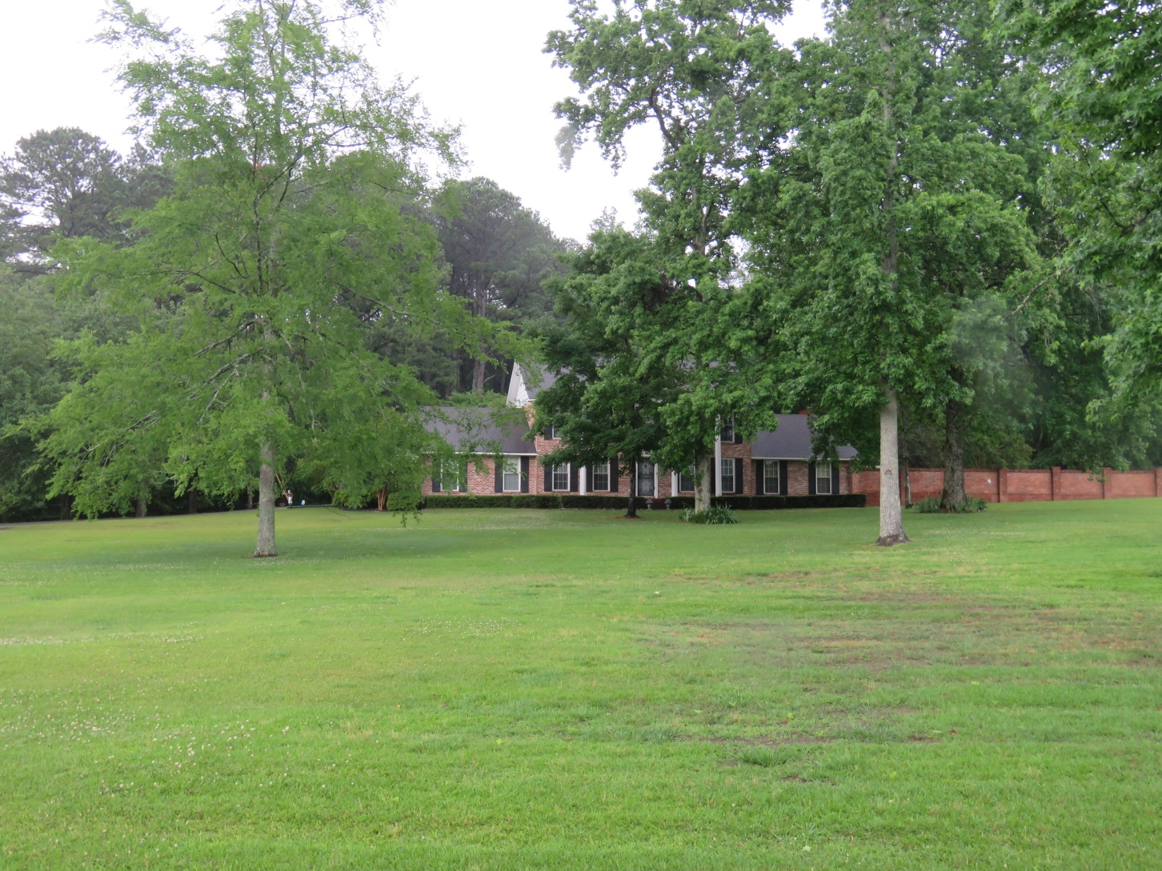
3316-16 Certificate to Consolidate & Subdivide

Slide 23
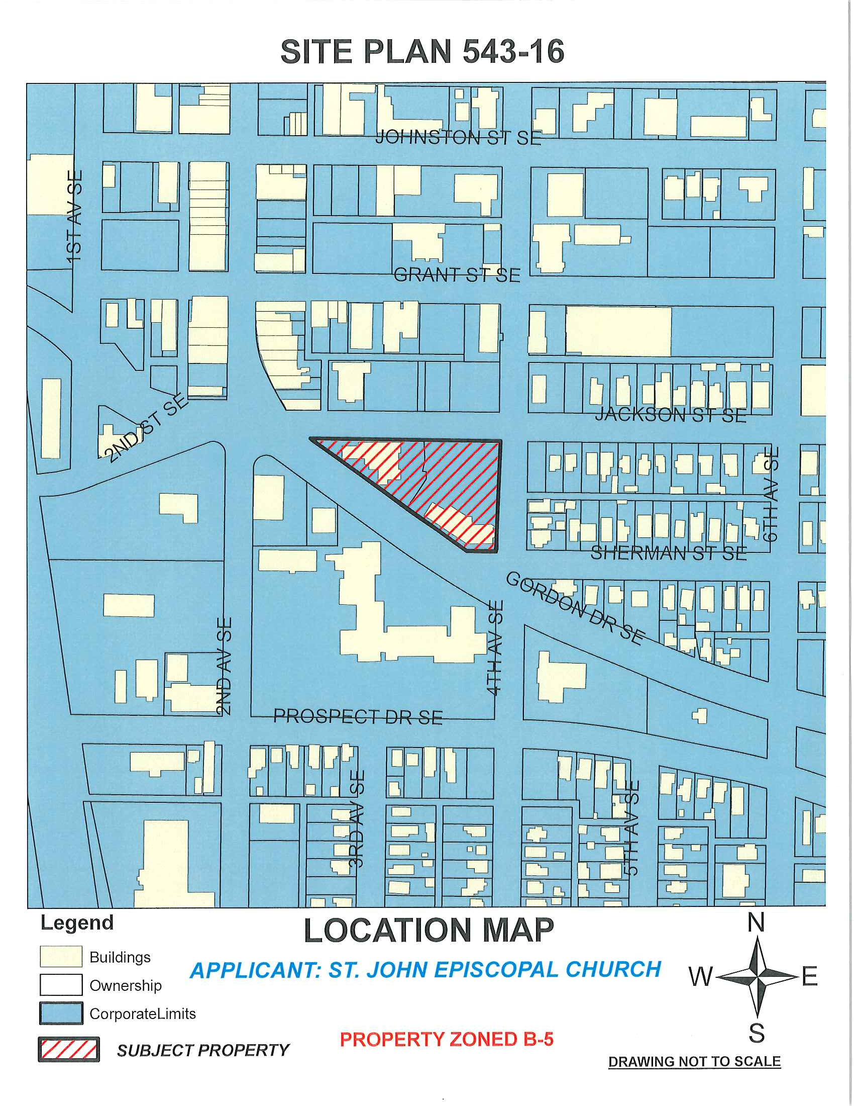

Slide 24
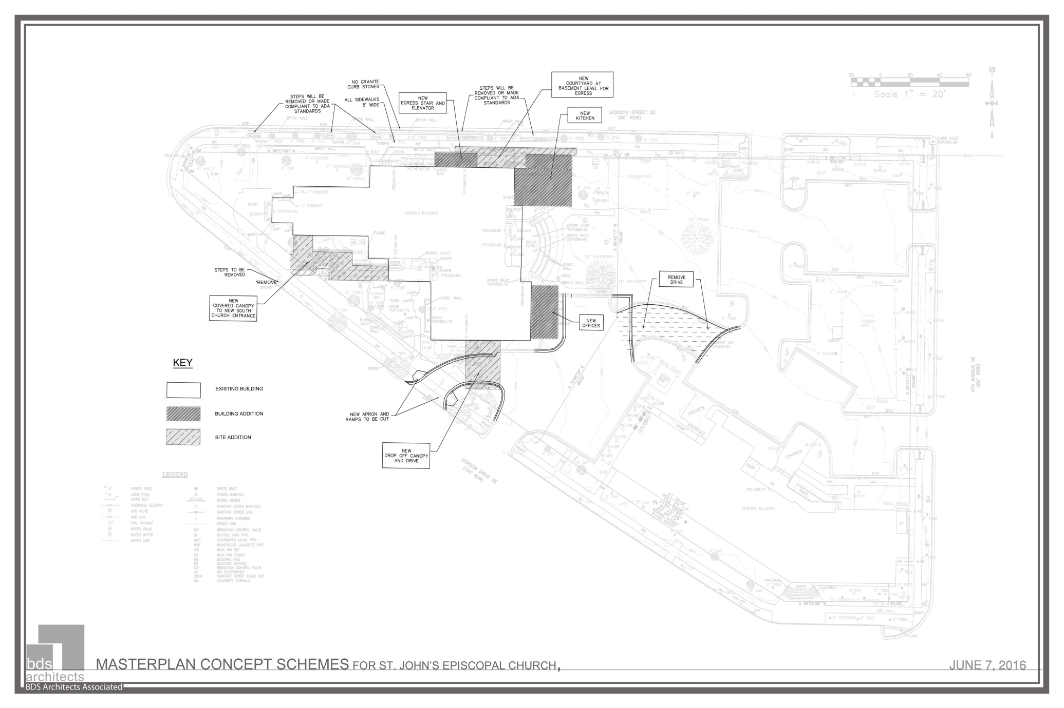

Slide 25
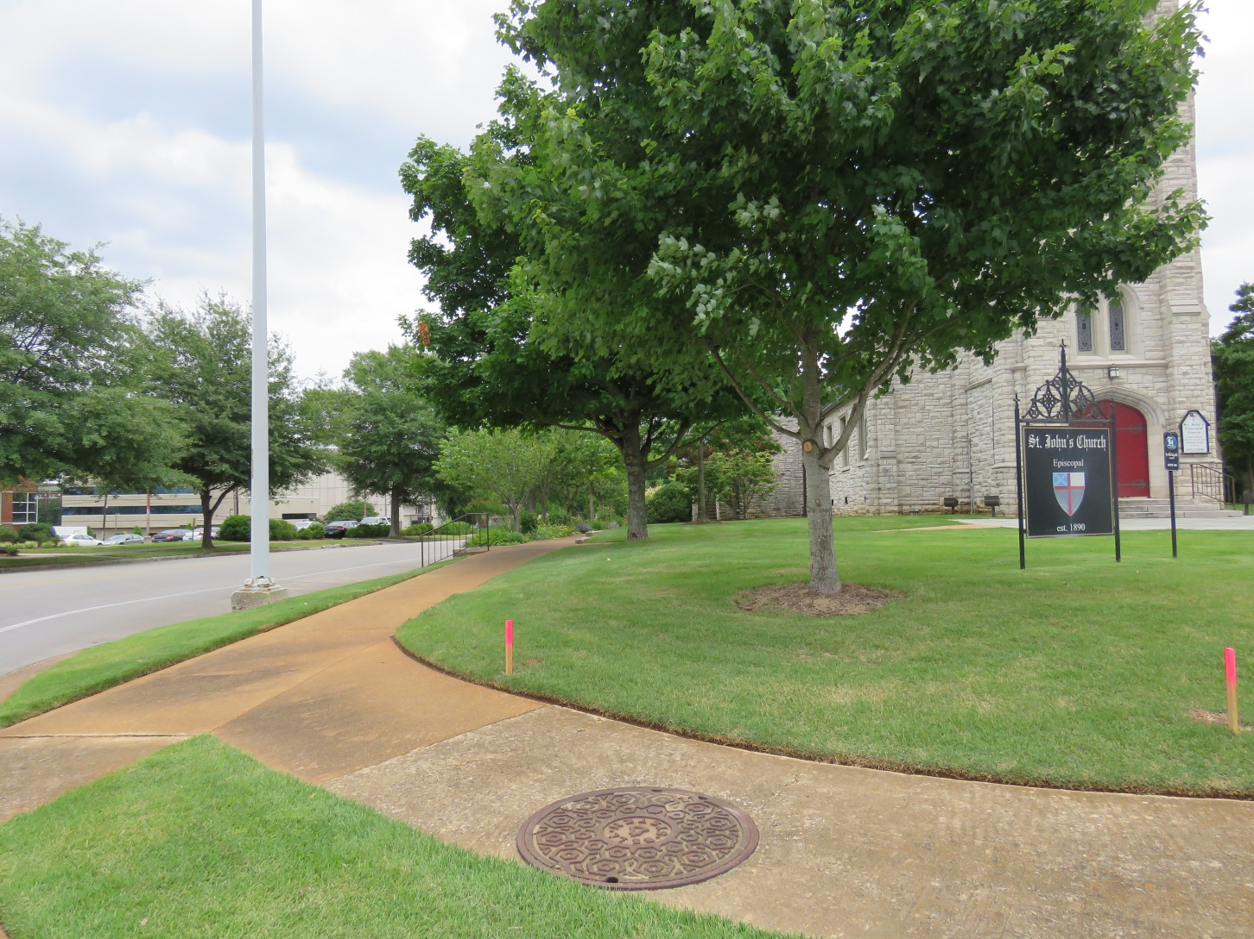
SITE PLAN 543-16

Slide 26
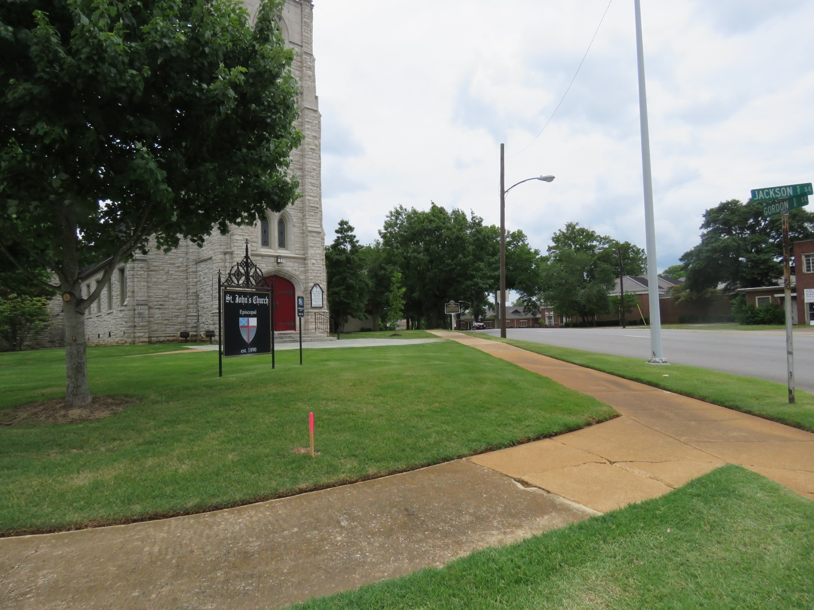
SITE PLAN 534-16

Slide 27
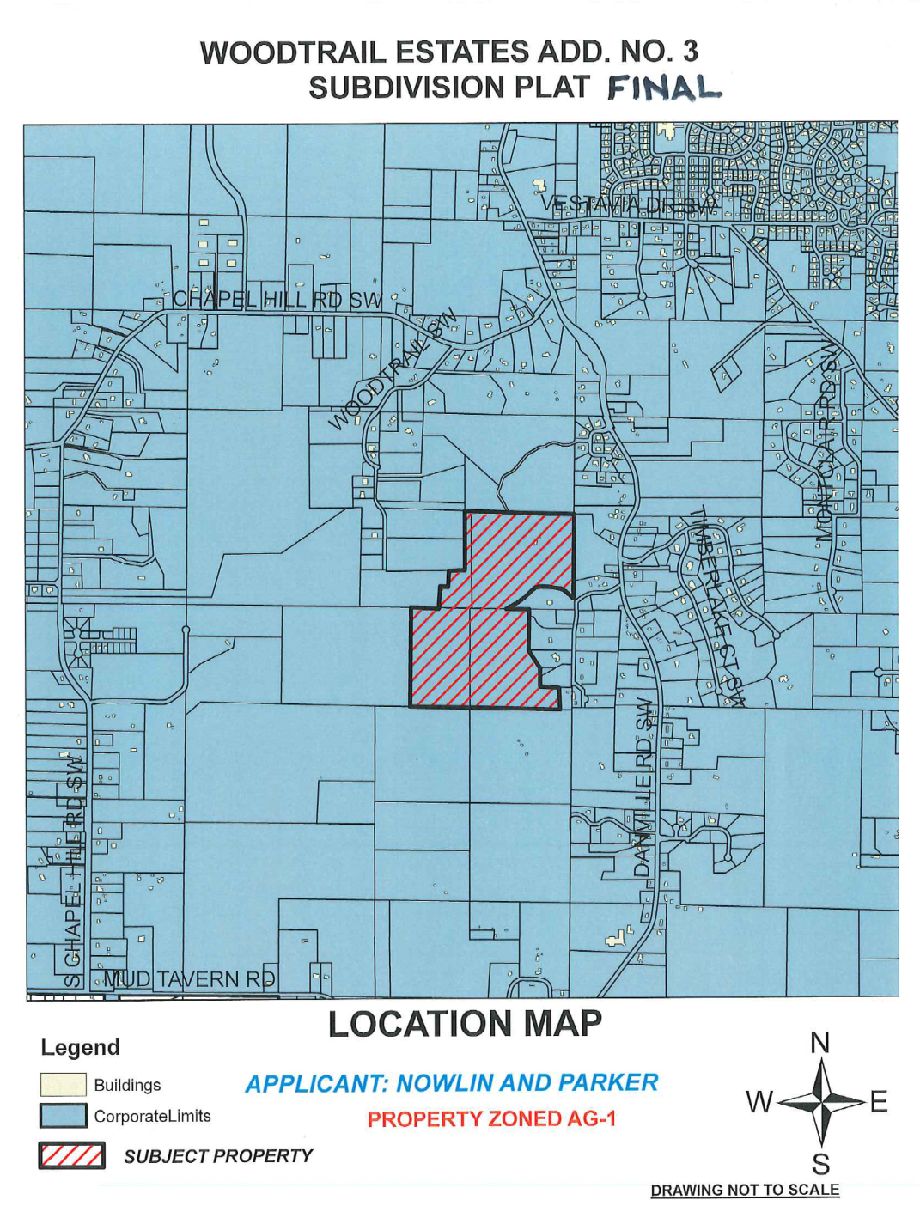

Slide 28
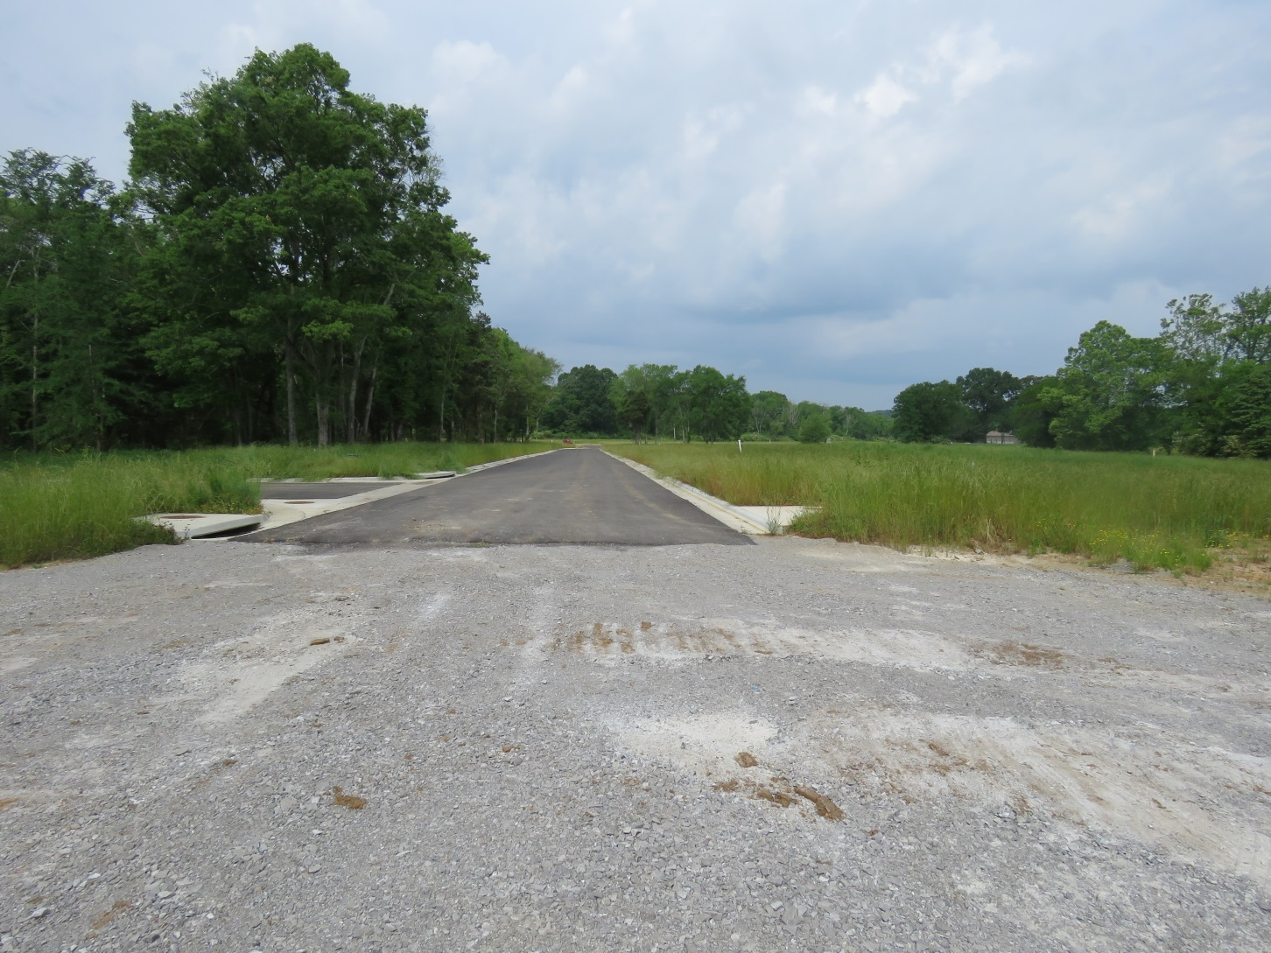
Woodtrail Estates, Add. #3

Slide 29
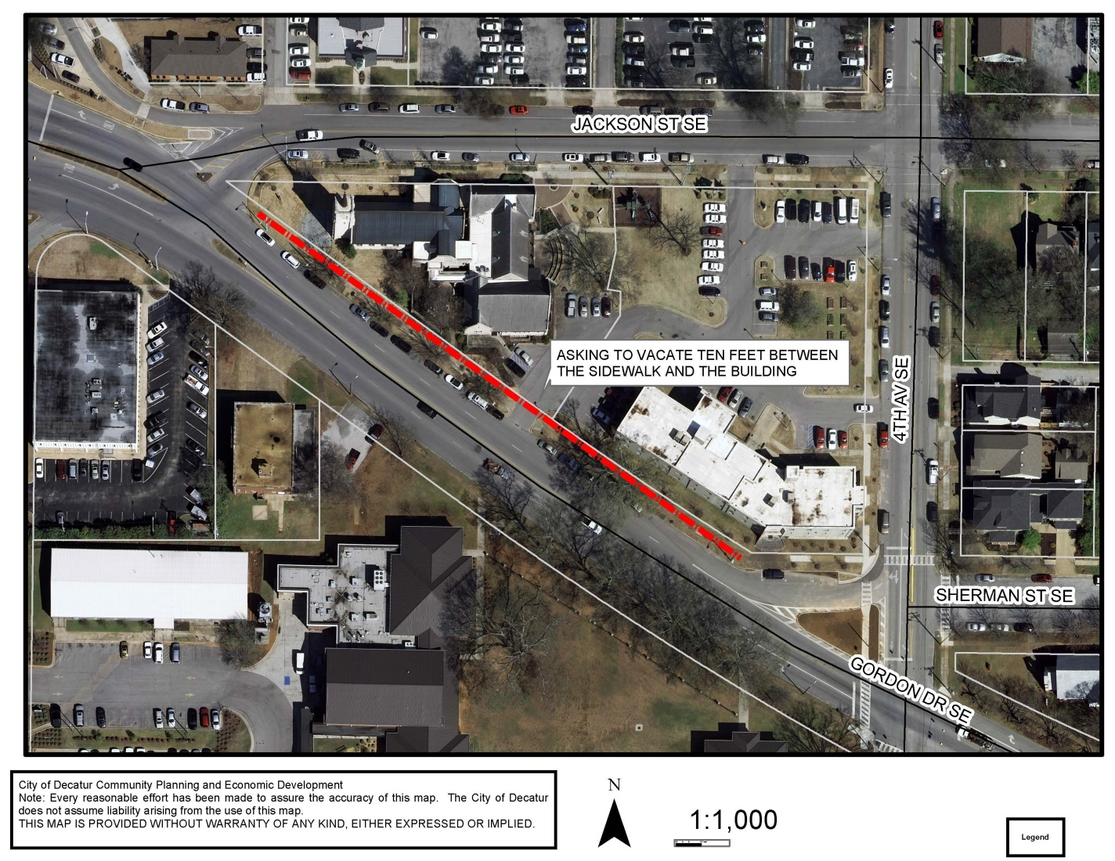
VACATION REQUEST 492-16

Slide 30
VACATION 492-16

